Slide 1

Dept. of CSA – BCA
I Year – I Semester
TO-DO LIST MANAGEMENT SYSTEM
Team Name: [SHELLDUO]
MEMBER 1: [SNEHA YADAV]
MEMBER 2: [KHUSH VYAS]
•
•
Roll No.: [2610520010]
Roll No.: [2610520032]
MEMBER 3: [KISHA YADAV]
MEMBER 4: [LACHAMPET KIRAN]
•
•
Roll No.: [2610520043]
Roll No.: [2610520053___________]
1

Slide 2

To-Do List Management System
$ ./to_do.sh
TASKORA — TO-DO LIST
1. Add task
2. View tasks
3. Mark complete
4. Delete task
5. Exit
Choose an option: 1
Enter task: Finish Linux project
Task added successfully!
A beginner-level Linux Bash shell scripting project
Linux Mini Project
Ubuntu / Bash
2026–2027
Notes:
Welcome. This mini project is a Student Marks & Grade Calculator written entirely in Bash and run from the Linux terminal on Ubuntu / WSL. Team of two students, academic year 2026–2027.

Slide 3


The Problem
The system should…
Allow users to add tasks
Display all saved tasks
Disorganized task tracking
Mark tasks as completed
Tasks kept in notebooks or memory can be forgotten, misplaced or difficult to update.
Delete tasks by ID
Store tasks in a text file
Provide a clear menu-driven interface
Notes:
Marks are normally added with a calculator or spreadsheet, then the average and grade are worked out separately. A simple command-line tool should do it all in one run.

Slide 4




Objectives
Bash basics
Variables & input
File handling
Use the Linux terminal to run a shell script
Read task descriptions and menu choices
Save and retrieve tasks from a text file
Decisions
Functions
Permissions
Use case statements for menu options
Separate add, view, complete and delete actions
Make the script executable with chmod
Notes:
Six learning goals: terminal and Bash basics, variables and input, arithmetic, decision making, functions, and file creation, permissions and execution. The end result is a small working project that can be demonstrated live.

Slide 5


Scope & Requirements
Platform
Ubuntu Linux / WSL
Hardware
Interface
Command-line menu
Computer or laptop
Minimum 4 GB RAM recommended
Keyboard and display
Input
Task description and task ID
Output
Task list and status
Software
Capacity
Multiple saved tasks
Ubuntu Linux or WSL
Bash shell and terminal
Text editor such as nano
Users
Students managing academic or personal work
Notes:
The project is for academic demonstration and beginner-level Linux learning. It handles one student record and five subjects at a time. No database and no graphical interface are needed — just Ubuntu or WSL, Bash and a text editor.

Slide 6



Existing vs Proposed System
Existing: manual tracking
Proposed: Bash script
Tasks written in notebooks or remembered mentally can be forgotten or become difficult to update.
A terminal program manages tasks through a menu and a persistent text file.
Easy to forget tasks
No automatic status tracking
Completed tasks may be unclear
Lists are harder to maintain
Add, view, complete and delete
Saves tasks between runs
Uses IDs for updates
Runs locally in Linux
Notes:
Compare the two approaches. The manual route is slow and error-prone and shows nothing about Linux. The proposed Bash script does the whole job in a single run from the terminal.

Slide 7
Program Workflow
1
2
3
4
Start
Initialize file
Display menu
Choose action
Launch the Bash script in the terminal
Create the task folder and tasks.txt if missing
Show the six available actions
Enter a menu number
5
6
7
8
Run action
Validate input
Update and display
Repeat / Exit
Add, search, complete, delete or view statistics
Check task text and task number
Save changes and show a result message
Return to the menu or choose Exit
Notes:
Walk through the eight steps: start, read the name, read five marks with validation, compute total and average, check that every mark is at least 40, assign a grade from the average, and display the final result.

Slide 8



System Design
Input
Processing
Output
Menu choice
Task description
Task ID
Validate menu choice
Append new tasks to file
Read and display records
Rewrite records for updates
Task IDs and descriptions
Pending / Completed status
Success or error messages
Notes:
Inputs are the student name and five marks. Processing adds the marks, divides by five, checks each mark against the pass mark of 40 and chooses a grade from the average. Outputs are name, total, average, pass/fail status and grade.

Slide 9

Task Status Criteria
ID
Pending
Done
Add
View
Complete
Delete
Unique number
P
C
Option 1
Option 2
Option 3
Option 4
Identifies a task
Not completed
Completed
Create a task
List saved tasks
Update status
Remove a task
Each record is stored as ID|STATUS|DESCRIPTION in a text file. P means Pending; C means Completed.
Notes:
The grade bands run from A+ for an average of 90 or more down to F. One important rule from the code: if any single subject is below 40, the result is FAIL and the grade is F, no matter how high the average is.

Slide 10
Implementation Steps
Create the project directory
$ mkdir -p "$HOME/TO_DO_LIST"
$ cd "$HOME/TO_DO_LIST"
1
Create the Bash script
$ nano todo.sh
# Paste the source code and save
2
Give execute permission
$ chmod +x todo.sh
3
Run the project
$ ./todo.sh
# Or run with: bash todo.sh
4
Notes:
Four terminal steps: make a project directory, create the script with nano, give it execute permission with chmod +x, and run it with ./marks_calculator.sh.

Slide 11
Key Source Code
Task file & menu
Task actions & exit
#!/bin/bash
TASK_FILE="$HOME/To-Do/tasks.txt"
if [ ! -f "$TASK_FILE" ]; then
mkdir -p "$HOME/To-Do"
touch "$TASK_FILE"
fi
while true; do
echo "WELCOME TO To-Do"
[ -s "$TASK_FILE" ] && cat -n "$TASK_FILE" ||
echo "No tasks yet."
echo "1. Add a New Task"
echo "2. Search for a Task"
echo "3. Mark Task as Completed"
echo "4. Delete a Task"
echo "5. View Task Statistics"
echo "6. Exit"
read -r -p "Enter your choice: " choice
case "$choice" in
1) read -r -p "Enter task: " task
if [ -n "$task" ]; then
echo "[ ] $task" >> "$TASK_FILE"
else echo "Task cannot be empty."; fi
;;
3) read -r -p "Task number: " num
total=$(wc -l < "$TASK_FILE")
if [[ "$num" =~ ^[0-9]+$ ]] &&
(( num>=1 && num<=total )); then
sed -i "${num}s/^\[ \]/[✓]/" "$TASK_FILE"
else echo "Invalid task number."; fi
;;
4) read -r -p "Task number: " num
total=$(wc -l < "$TASK_FILE")
if [[ "$num" =~ ^[0-9]+$ ]] &&
(( num>=1 && num<=total )); then
sed -i "${num}d" "$TASK_FILE"
else echo "Invalid task number."; fi
;;
5) total=$(wc -l < "$TASK_FILE")
completed=$(grep -c '^\[✓\]' "$TASK_FILE")
pending=$(grep -c '^\[ \]' "$TASK_FILE")
echo "Total: $total Done: $completed Pending: $pending"
;;
6) echo "Thank you for using To-Do list!"; break ;;
*) echo "Invalid choice. Try again." ;;
esac
done
Notes:
Condensed excerpts of marks_calculator.sh. Left: the read_mark function loops until the input is a number from 0 to 100 and prints an error to stderr otherwise. Right: total and average use $(( )); any mark below 40 forces FAIL and grade F, otherwise an if-elif chain picks the grade from the average. The full script is in the project report.

Slide 12
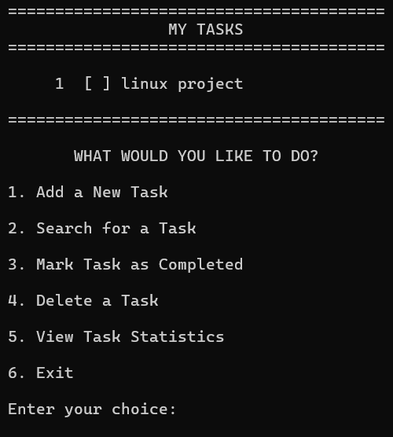
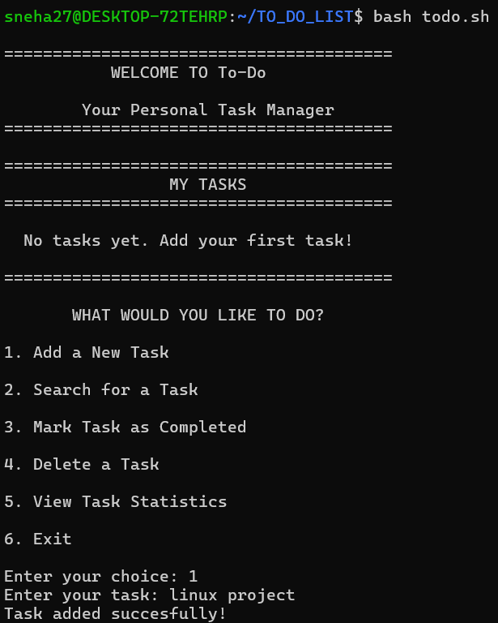
Sample Execution
$ ./to_do.sh
===== TASKORA: TO-DO LIST =====
1) Add a New Task
2) Search for a Task
3) Mark Task as Completed
4) Delete a Task
5) View Task Statistics
6) Exit
Enter your choice: 1
Enter your task: Submit Linux assignment
Task added successfully!
Enter your choice: 2
Enter a word to search for: Linux
Search completed.
Enter your choice: 3
Enter task number to complete: 1
Task marked as completed!
The menu repeats after each action. Tasks are stored in tasks.txt and remain available when the script is run again.
1 task saved
Saved locally · Pending / Completed

Slide 13
Testing
Test
Action / Input
Expected result
1
Add valid task
Task is saved and a success message appears.
2
View tasks
Saved task ID, description and status are displayed.
3
Complete an existing task ID
That task status changes to Completed.
4
Delete an existing task ID
The selected task is removed from the list.
5
Empty list / empty task / invalid choice
Helpful message is shown; no invalid task is saved.
6
Exit and run the script again
Previously saved tasks are still available.
Testing checks the main operations, input handling, and saving tasks between runs.

Slide 14
Project Modules
1. Task Input & Menu
2. Task & File Management
CORE FUNCTIONS
CORE FUNCTIONS
• Display menu options
• Read and validate the user choice
• Accept task descriptions
• Reject empty task input
• Add, view, complete and delete tasks
• Assign task IDs
• Store records in tasks.txt
• Update and display task status
DELIVERABLES
Menu-driven Bash interface
Validated task input
DELIVERABLES
Task storage file
Task status and record updates
Notes:
Introduce each team member and their contribution. Replace “Student 1” and “Student 2” with the actual names.

Slide 15

Advantages & Limitations
Advantages
Limitations
Beginner-friendly
Runs in the Linux terminal
Saves tasks between sessions
Demonstrates Bash functions
No database required
Text-only interface
One local data file
No due dates or reminders
Not designed for multiple users
Notes:
Strengths: simple, terminal-based, no extra software, easy to extend. Limitations: one student at a time, no permanent storage, integer averages and no GUI — which leads into the future enhancements.

Slide 16



Future Enhancements
Due dates
Search and filter
Add deadlines and priority levels
Find tasks by keyword or status
Categories
Notifications
Group tasks by subject or project
Add reminders and export reports
Notes:
Next steps: store records in a CSV file, support many students with roll number and course details, add a menu with Add, Search, Update and Delete, and generate reports automatically, optionally scheduled with cron.

Slide 17
Conclusion
The To-Do List Management System shows how Linux Bash can solve an everyday problem. It combines menus, functions, conditions and file handling to add, display, complete and delete tasks.
Learning outcomes
Navigate directories
chmod permissions
Variables and input
File handling
Thank you
case / if logic
Functions
Testing and debugging
Test and debug
Notes:
Summarise: the project combines basic Linux commands with core scripting ideas and gives a base for bigger Linux projects. Thank the audience and invite questions.

